Slide 1
Box-Cox Transformation

Slide 2
1. Introduction :-
Most of the data deviates from normality and that therefore requires treatment such that the assumption is met or approximated.
Normalizing data is particularly relevant when parametric tests are used.
One of the methods to enhance data’s normality is via transformations.
Transforming data has been found helpful in revealing statistically significant differences across experiments that would have been otherwise missed if such treatment had not been applied
A family of transformations commonly used in various research fields is known as the Box–Cox transformation.

Slide 3
2. B0x-Cox Transformation:-
Box-Cox transformation is a statistical technique that transforms your target variable so that your data closely resembles a normal distribution.
Box and Cox proposed a parametric power transformation technique defined by a single parameter λ.
We usually estimate λ of maximum likelihood estimators (MLEs).
Statistical analysis on the transformed data is performed assuming that λ is known.
However, for any other value of λ, say λ₀, the normality assumption does not hold.

Slide 4

3. Methodology
Let $y={\left(y_{1},y_{2},…,y_{n}\right)}^{′}$ be the data on which the Box-Cox transformation is to be applied. Box and Cox [7] defined their transformation as
$y^{\left(λ\right)}=\left\{\begin{matrix}\frac{y^{λ}−1}{λ{\overset{˙}{y}}^{λ−1}}, & \text{if} λ≠0 \\ \overset{˙}{y}\ln{y}, & \text{if} λ=0\end{matrix}\right.$ ……(1)
where $\overset{˙}{y}=\ln^{−1}⁡\left[1/n∑_{i=1}^{n} ln⁡y_{i}\right]$.

Slide 5
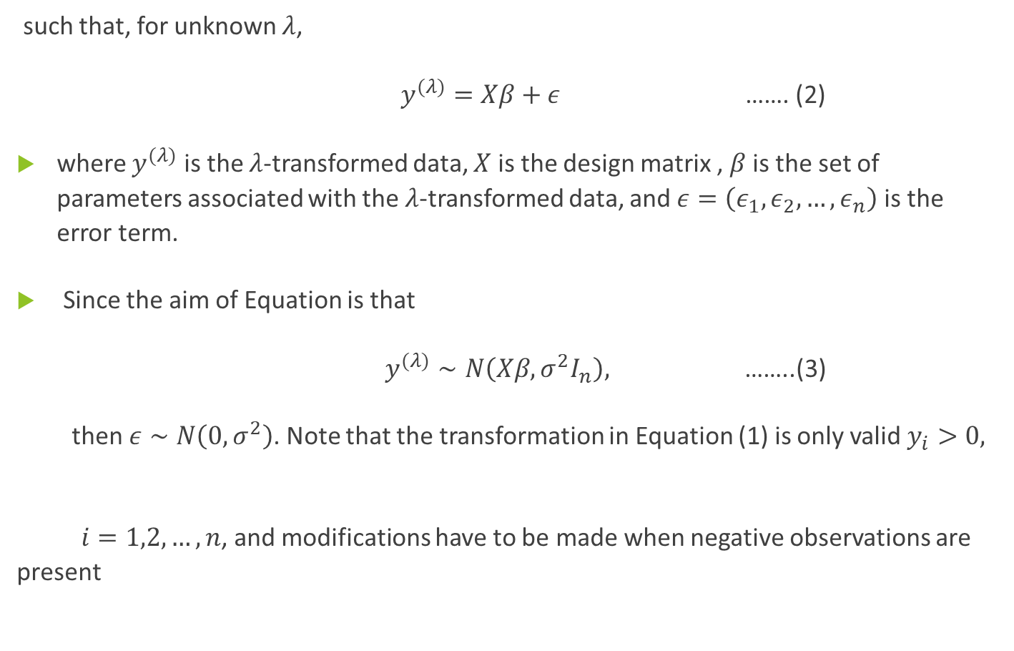
such that, for unknown $λ$,
$y^{(λ)}=Xβ+ε$ ……. (2)
where $y^{(λ)}$ is the $λ$-transformed data, $X$ is the design matrix , $β$ is the set of parameters associated with the $λ$-transformed data, and $ε=\left(ε_{1},ε_{2},…,ε_{n}\right)$ is the error term.
Since the aim of Equation is that
$y^{(λ)}∼N\left(Xβ,σ^{2}I_{n}\right),$ ……..(3)
then $ε∼N\left(0,σ^{2}\right)$. Note that the transformation in Equation (1) is only valid $y_{i}>0,$
$i=1,2,…,n$, and modifications have to be made when negative observations are present

Slide 6
3.1. A p-VALUE-BASED APPROACH FOR λ
As reported above, λ has traditionally been estimated via the MLE method particularly via profile log-likelihoods.
Our method is characterized by pairing the value of λ, used to transform a specific data set, with the associated p-value of a desired normality test performed on the λ-transformed data.
A key characteristic of our method is that the selected λ is that paired with the largest p-value given by the desired normality test.

Slide 7
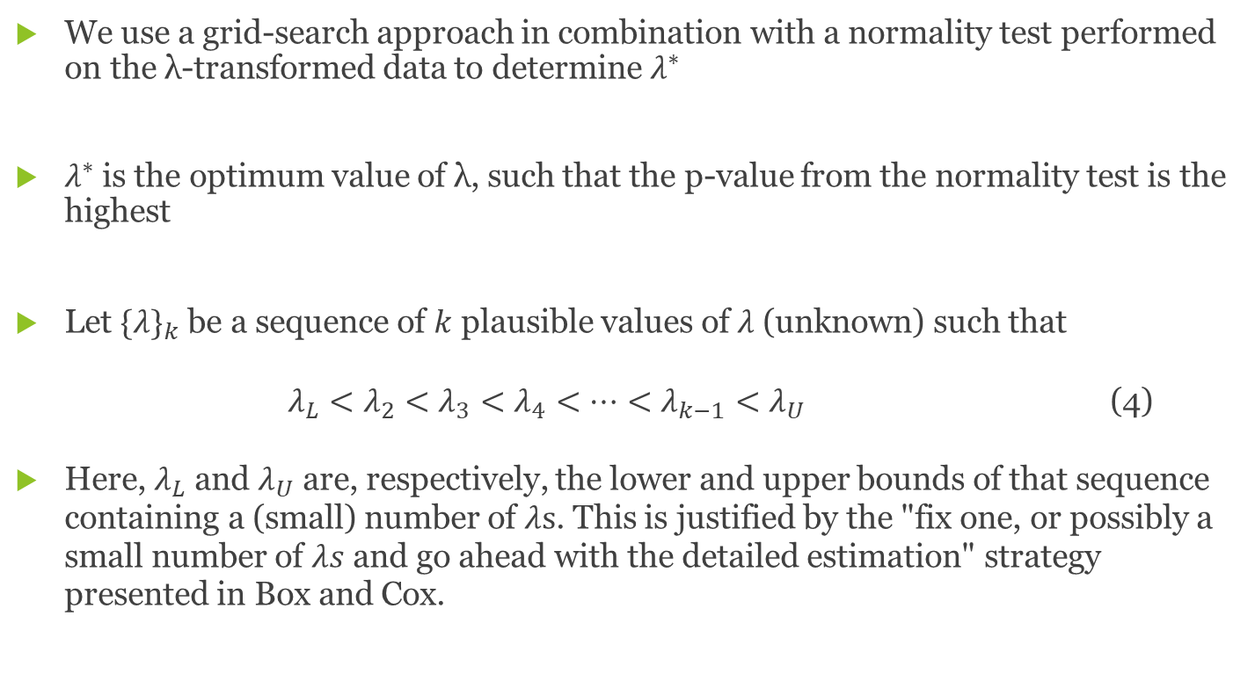
3.2. Procedure
We use a grid-search approach in combination with a normality test performed on the λ-transformed data to determine $λ^{∗}$
$λ^{∗}$ is the optimum value of λ, such that the p-value from the normality test is the highest
Let $\{λ\}_{k}$ be a sequence of $k$ plausible values of $λ$ (unknown) such that
$λ_{L}<λ_{2}<λ_{3}<λ_{4}<⋯<λ_{k−1}<λ_{U}$ (4)
Here, $λ_{L}$ and $λ_{U}$ are, respectively, the lower and upper bounds of that sequence containing a (small) number of $λs$. This is justified by the "fix one, or possibly a small number of $λs$ and go ahead with the detailed estimation" strategy presented in Box and Cox.

Slide 8
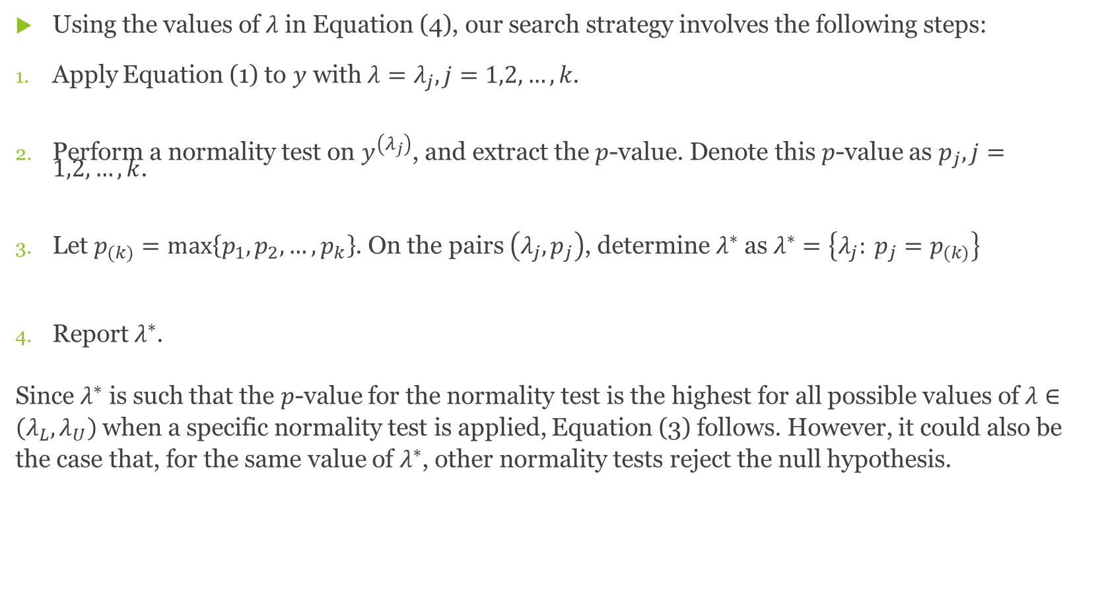
Using the values of $λ$ in Equation (4), our search strategy involves the following steps:
Apply Equation (1) to $y$ with $λ=λ_{j},j=1,2,…,k$.
Perform a normality test on $y^{\left(λ_{j}\right)}$, and extract the $p$-value. Denote this $p$-value as $p_{j},j=1,2,…,k$.
Let $p_{(k)}=max\left\{p_{1},p_{2},…,p_{k}\right\}$. On the pairs $\left(λ_{j},p_{j}\right)$, determine $λ^{∗}$ as $λ^{∗}=\left\{λ_{j}: p_{j}=p_{(k)}\right\}$
Report $λ^{∗}$.
Since $λ^{∗}$ is such that the $p$-value for the normality test is the highest for all possible values of $λ∈\left(λ_{L},λ_{U}\right)$ when a specific normality test is applied, Equation (3) follows. However, it could also be the case that, for the same value of $λ^{∗}$, other normality tests reject the null hypothesis.

Slide 9
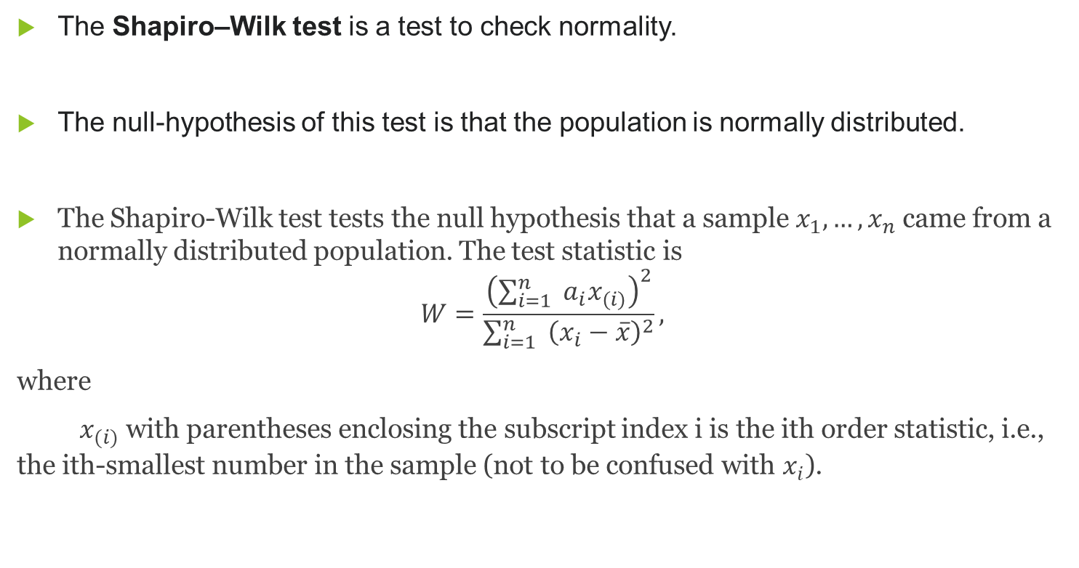
3.3.Shapiro-Wilk Test
The Shapiro–Wilk test is a test to check normality.
The null-hypothesis of this test is that the population is normally distributed.
The Shapiro-Wilk test tests the null hypothesis that a sample $x_{1},…,x_{n}$ came from a normally distributed population. The test statistic is
$$W=\frac{{\left(\sum_{i=1}^{n}{ } a_{i}x_{(i)}\right)}^{2}}{\sum_{i=1}^{n}{ } {\left(x_{i}−\overset{‾}{x}\right)}^{2}},$$
where
$x_{(i)}$ with parentheses enclosing the subscript index i is the ith order statistic, i.e., the ith-smallest number in the sample (not to be confused with $x_{i}$).

Slide 10
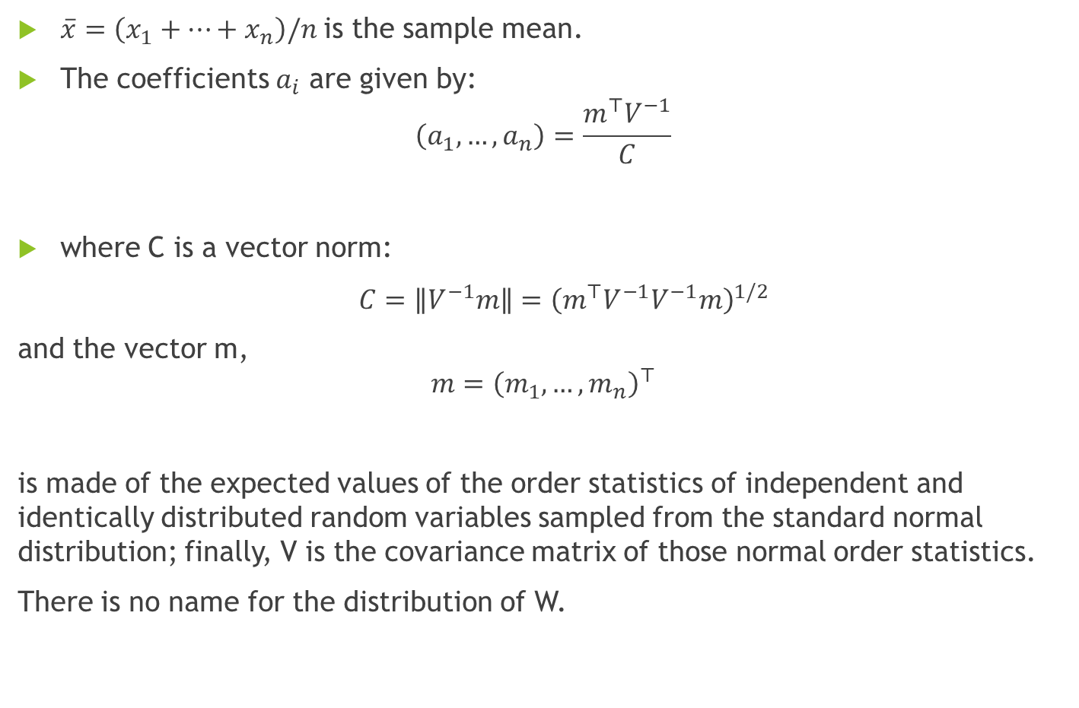
$\overset{‾}{x}=\left(x_{1}+⋯+x_{n}\right)/n$ is the sample mean.
The coefficients $a_{i}$ are given by:
$$\left(a_{1},…,a_{n}\right)=\frac{m^{⊤}V^{−1}}{C}$$
where C is a vector norm:
$C=∥V^{−1}m∥={\left(m^{⊤}V^{−1}V^{−1}m\right)}^{1/2}$
and the vector m,
$$m={\left(m_{1},…,m_{n}\right)}^{⊤}$$
is made of the expected values of the order statistics of independent and identically distributed random variables sampled from the standard normal distribution; finally, V is the covariance matrix of those normal order statistics.
There is no name for the distribution of W.

Slide 11
Interpretation :-
The null-hypothesis of this test is that the population is normally distributed. Thus, if the p value is less than the chosen alpha level, then the null hypothesis is rejected and there is evidence that the data tested are not normally distributed. On the other hand, if the p value is greater than the chosen alpha level, then the null hypothesis (that the data came from a normally distributed population) can not be rejected.

Slide 12

4. Box Tidewell Transformation
Assume that the response variable $y$ is related to a power of the regressor, say $ξ=x^{a}$, as
$$𝔼\left[y\right]=f\left(ξ,β_{0},β_{1}\right)=β_{0}+β_{1}ξ$$
Where,
$ξ=\left\{\begin{matrix}x^{α}, & \text{if} a≠0 \\ ln⁡x, & \text{if} a=0\end{matrix}\right.$
and $β_{0},β_{1}$, and $α$ are unknown parameters.

Slide 13
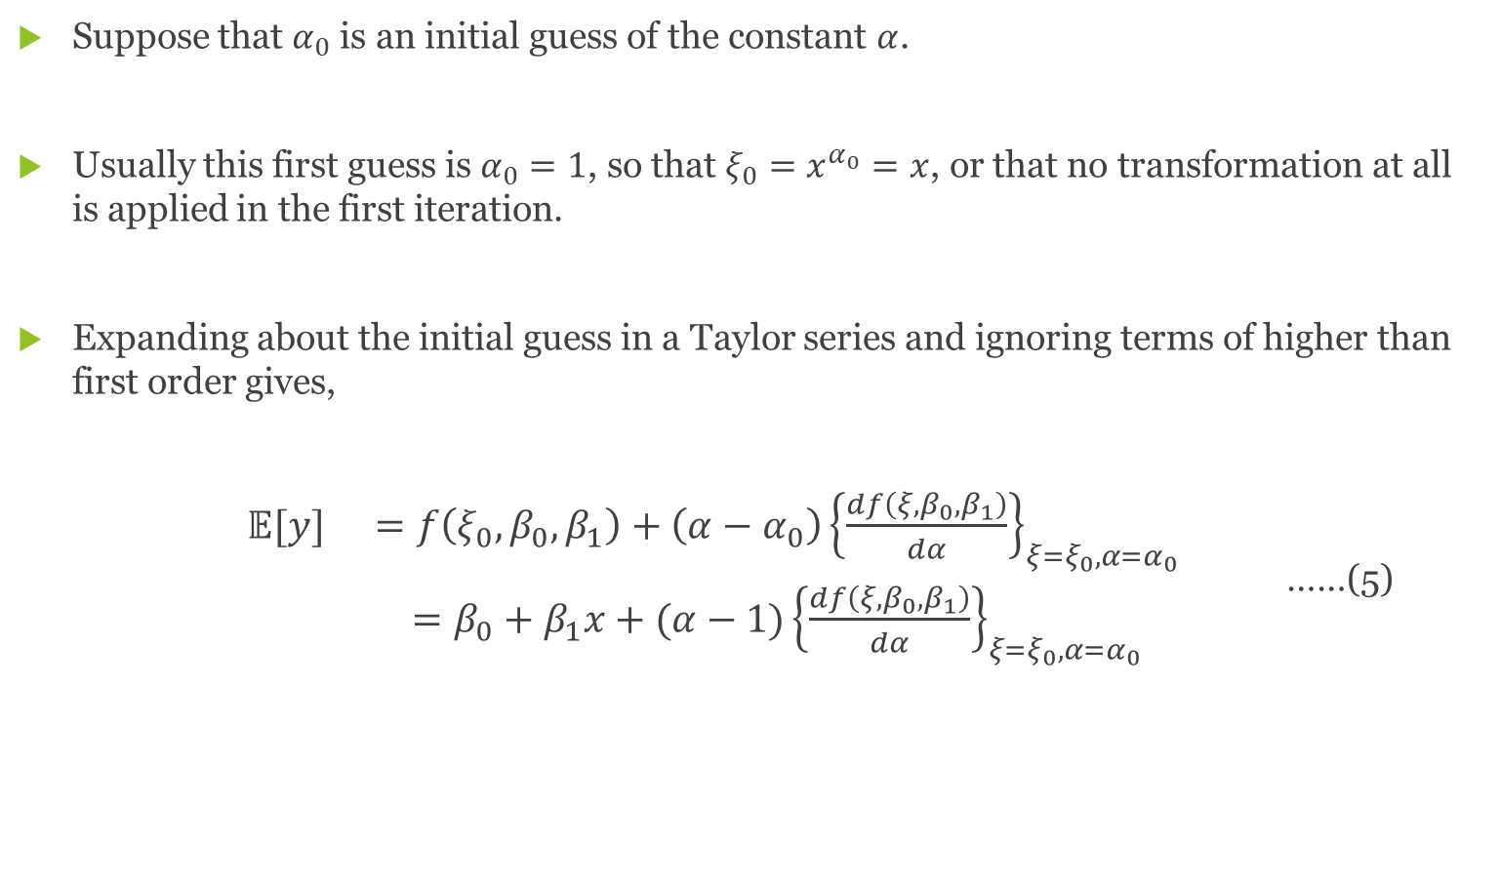
Suppose that $α_{0}$ is an initial guess of the constant $α$.
Usually this first guess is $α_{0}=1$, so that $ξ_{0}=x^{α_{0}}=x$, or that no transformation at all is applied in the first iteration.
Expanding about the initial guess in a Taylor series and ignoring terms of higher than first order gives,
$\begin{matrix}𝔼[y] & =f\left(ξ_{0},β_{0},β_{1}\right)+\left(α−α_{0}\right){\left\{\frac{df\left(ξ,β_{0},β_{1}\right)}{dα}\right\}}_{ξ=ξ_{0},α=α_{0}} \\ & =β_{0}+β_{1}x+(α−1){\left\{\frac{df\left(ξ,β_{0},β_{1}\right)}{dα}\right\}}_{ξ=ξ_{0},α=α_{0}}\end{matrix}$ ……(5)

Slide 14

The term in braces in Eq. (5) can be written as
$${\left\{\frac{df\left(ξ,β_{0},β_{1}\right)}{dα}\right\}}_{ξ=ξ_{0},α=α_{0}}={\left\{\frac{df\left(ξ,β_{0},β_{1}\right)}{dξ}\right\}}_{ξ=ξ_{0}}{\left\{\frac{dξ}{dα}\right\}}_{α=α_{0}}.$$
Since the form of the transformation is known, that is, $ξ=x^{α}$, we have $dξ/dα=xln⁡x$.
Furthermore,
$${\left\{\frac{df\left(ξ,β_{0},β_{1}\right)}{dξ}\right\}}_{ξ=ξ_{0}}={\left\{\frac{d\left(β_{0}+β_{1}x\right)}{dξ}\right\}}_{ξ=ξ_{0}}=β_{1}$$

Slide 15
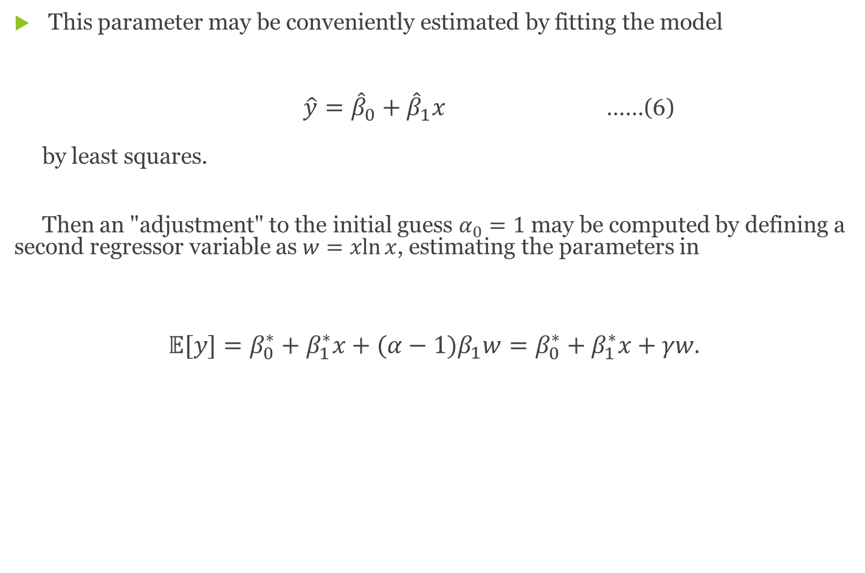
This parameter may be conveniently estimated by fitting the model
$\hat{y}={\hat{β}}_{0}+{\hat{β}}_{1}x$ ……(6)
by least squares.
Then an "adjustment" to the initial guess $α_{0}=1$ may be computed by defining a second regressor variable as $w=xln⁡x$, estimating the parameters in
$$𝔼[y]=β_{0}^{∗}+β_{1}^{∗}x+(α−1)β_{1}w=β_{0}^{∗}+β_{1}^{∗}x+γw.$$

Slide 17
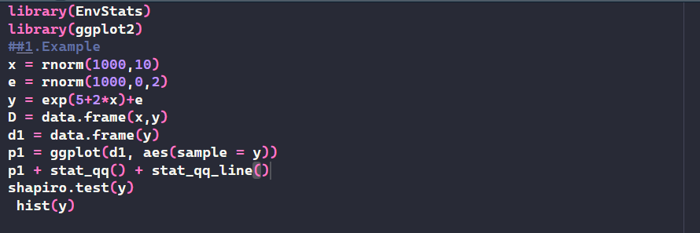
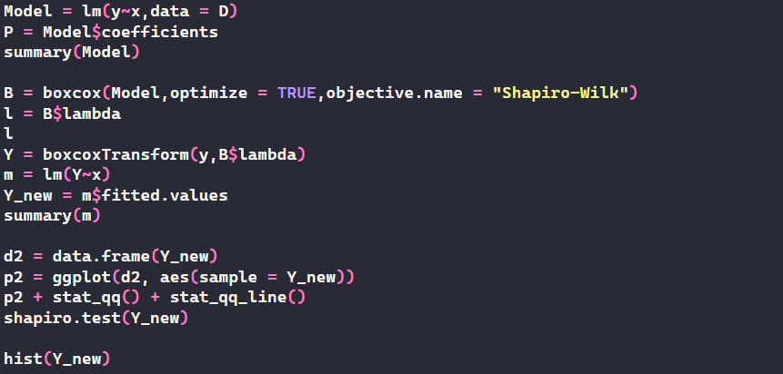
Simulation

Slide 18
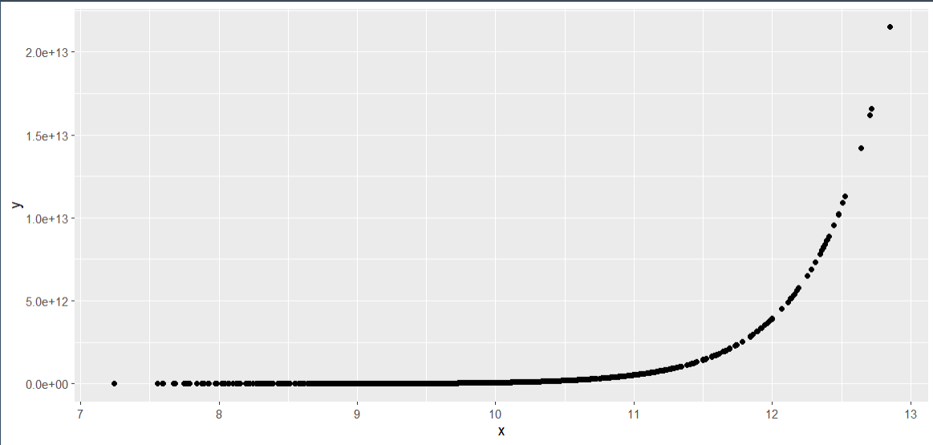
Scatterplot

Slide 19
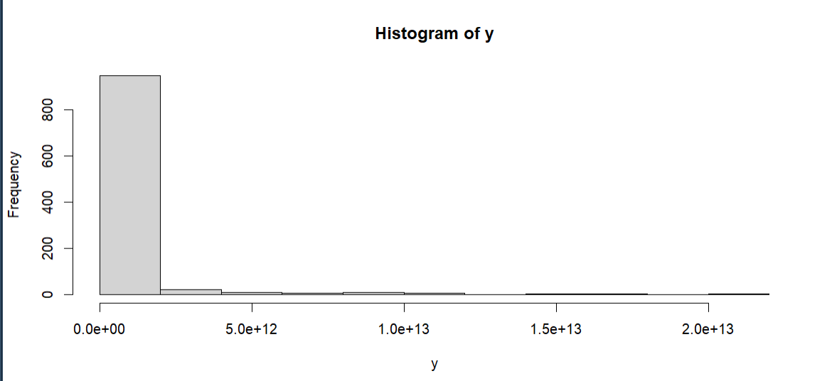
Histogram of the dependent Variable

Slide 20
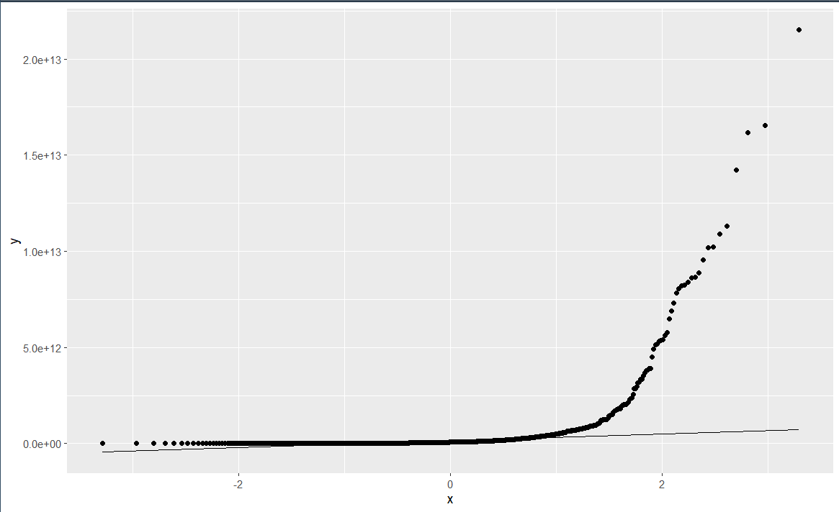
Q-Q Plot

Slide 21
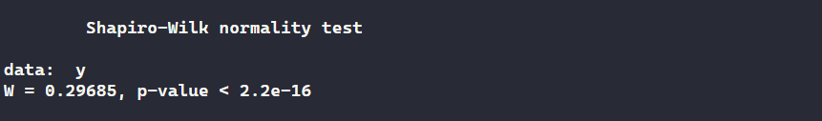
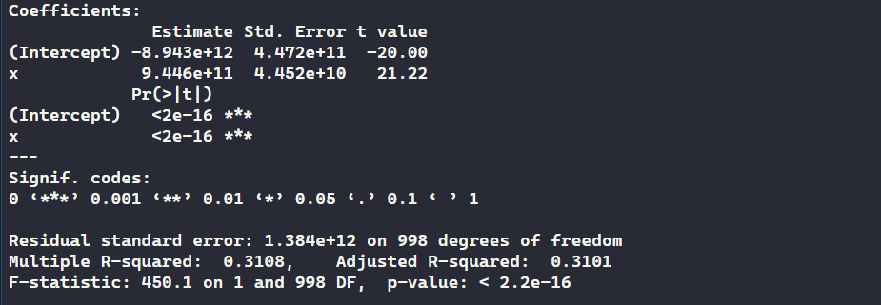
Summary

Slide 22
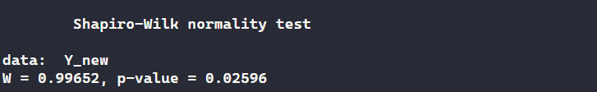
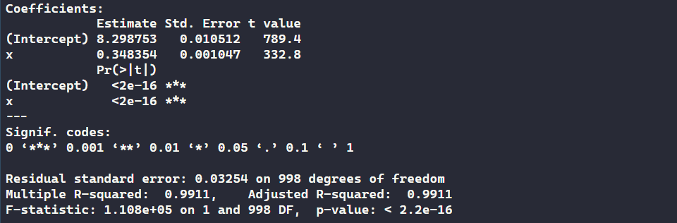
Summary

Slide 23
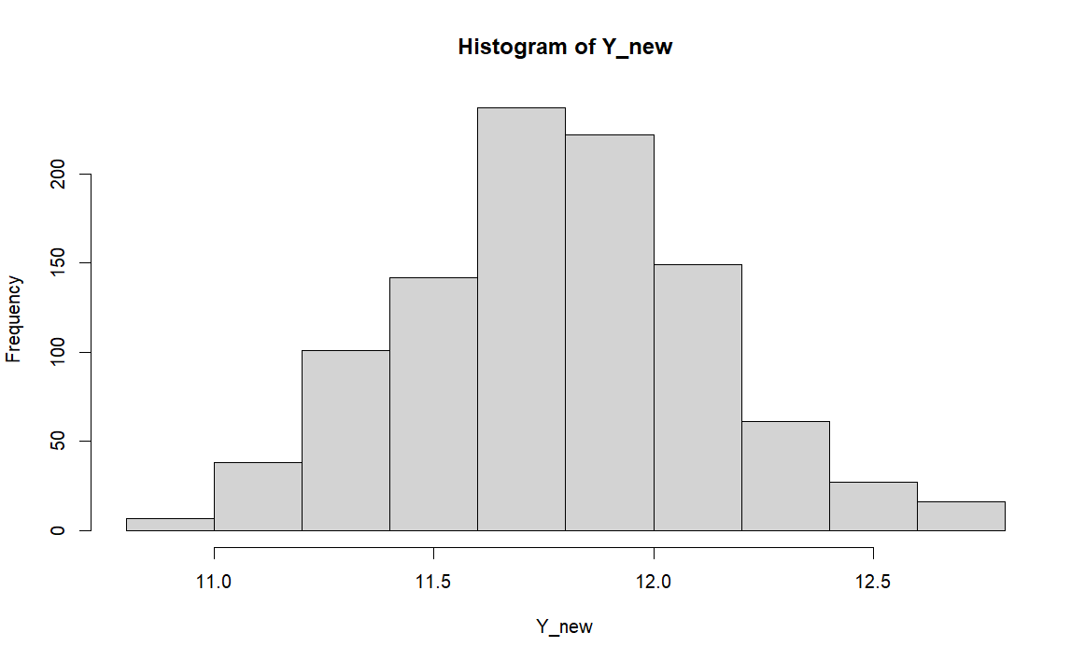
Histogram(Transformed Variable)

Slide 24
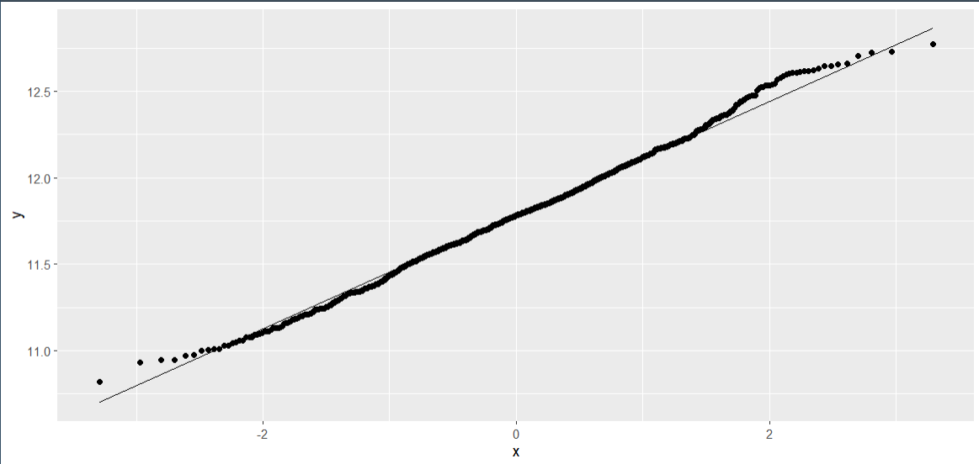
Q-Q Plot

Slide 25
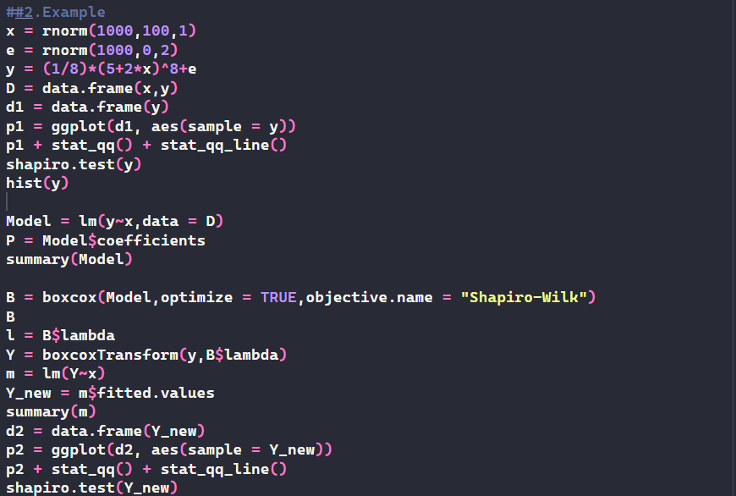
Example - 2

Slide 26
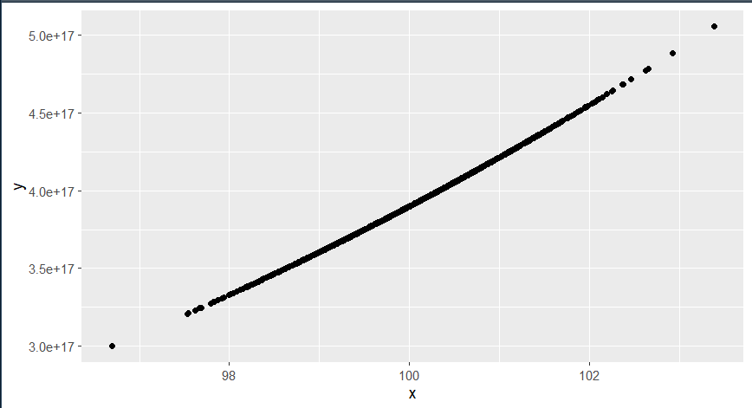
Scatterplot

Slide 27
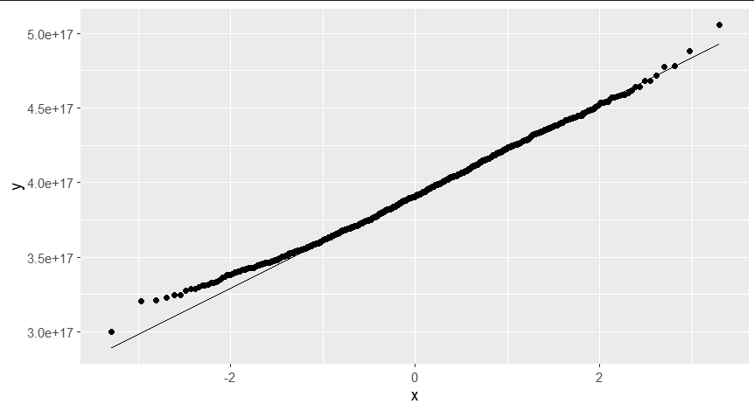
Q-Q Plot

Slide 28
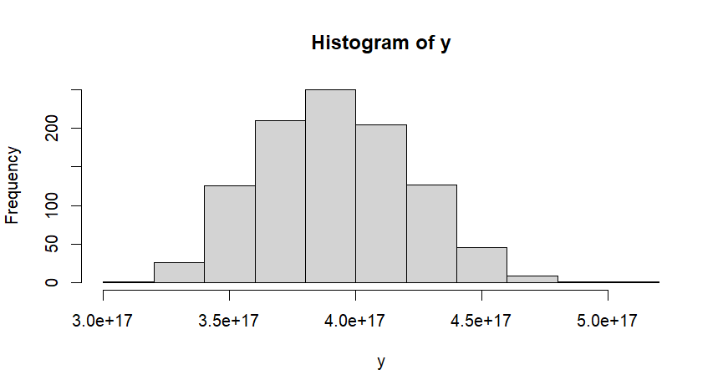
Histogram

Slide 29
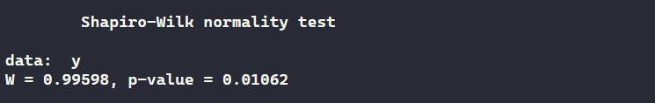
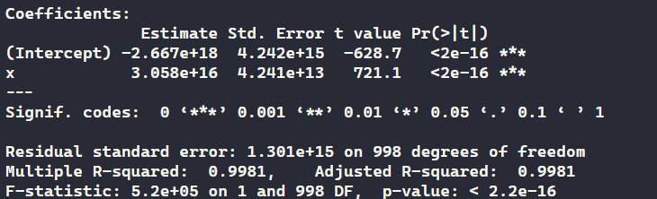
Summary

Slide 30
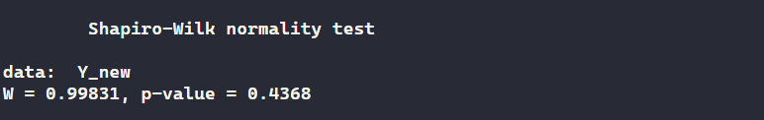
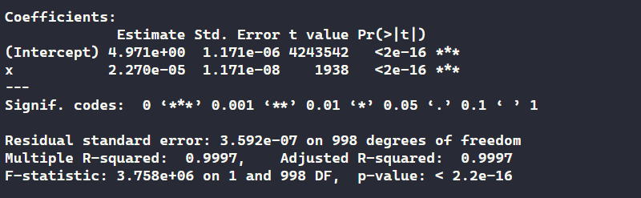
Summary

Slide 31
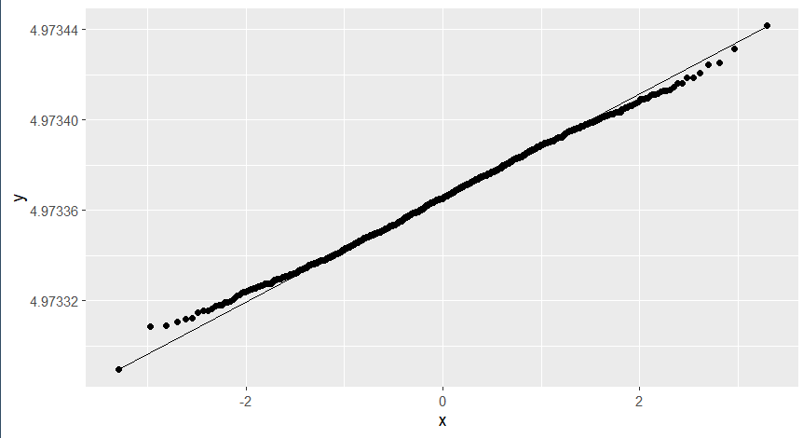
Q-Q Plot

Slide 32
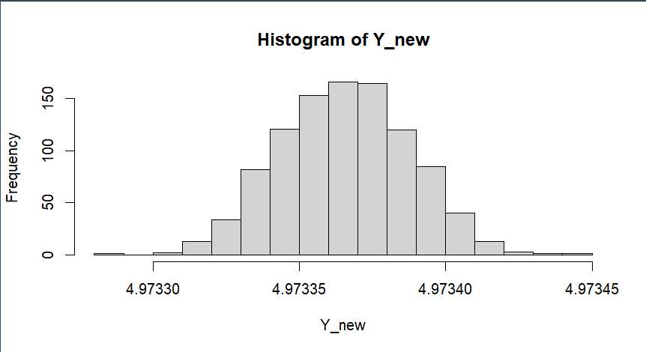
Histogram(transformed Variable)

Slide 33
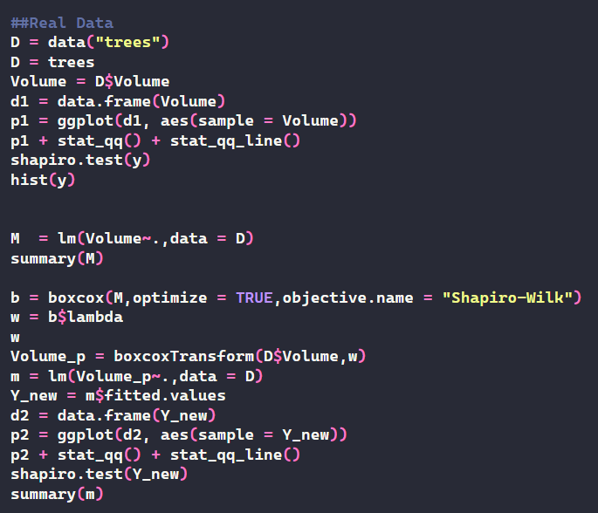
Real Data Example

Slide 34
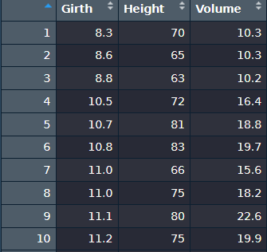
Data

Slide 35
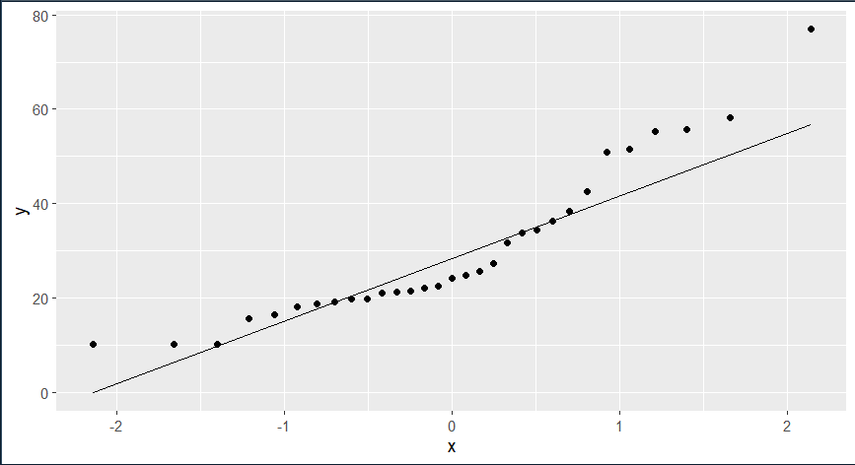
Q-Q Plot

Slide 36
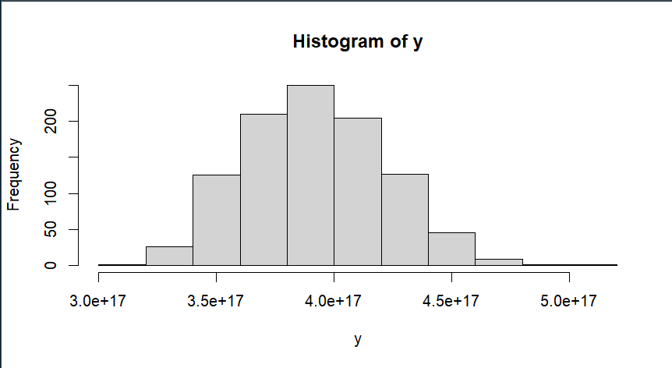
Histogram

Slide 37
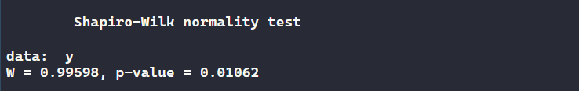
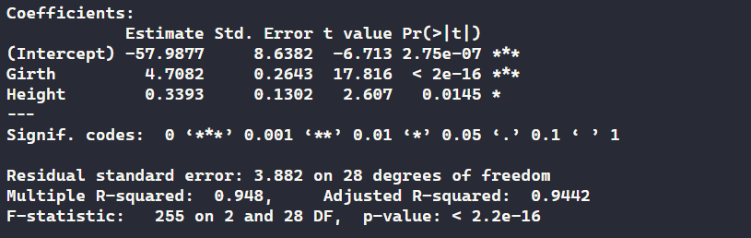
Summary

Slide 38
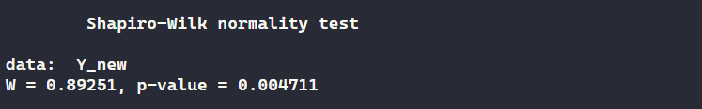
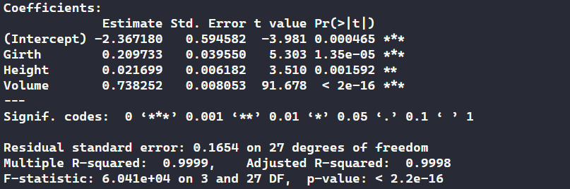
Summary

Slide 39

Q-Q Plot

Slide 40
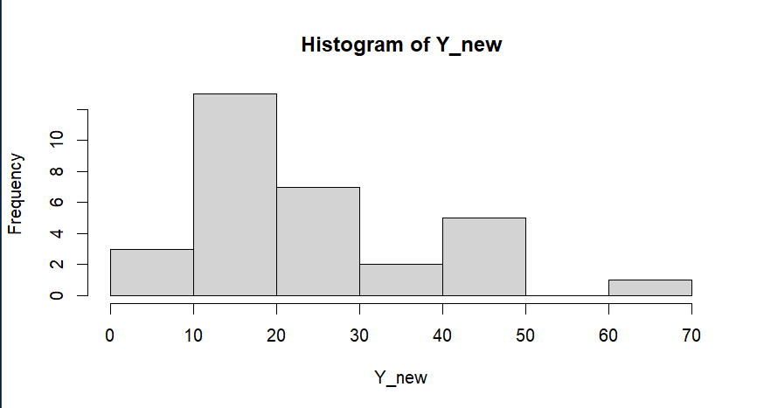
Histogram

Slide 41
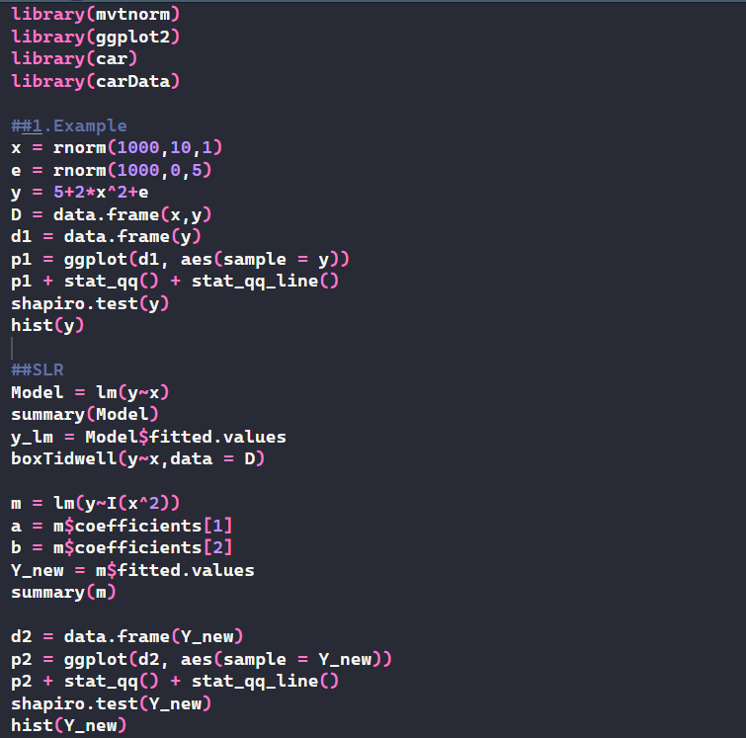
Box-Tidewell

Slide 42
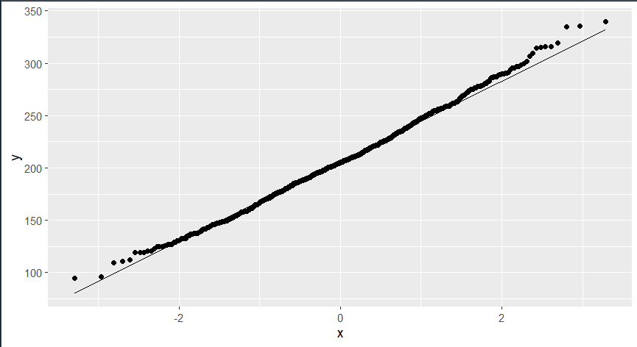
Q-Q Plot

Slide 43
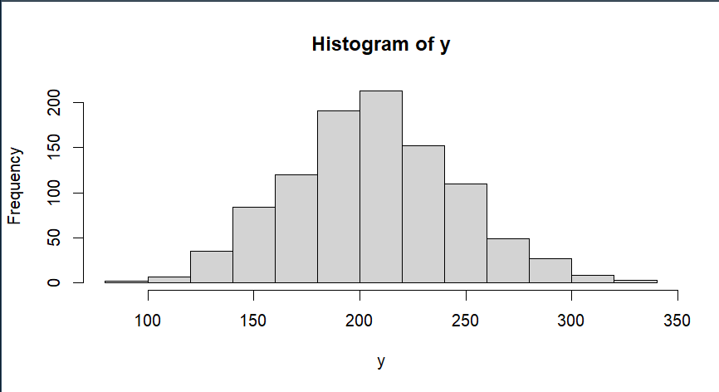
Histogram

Slide 44
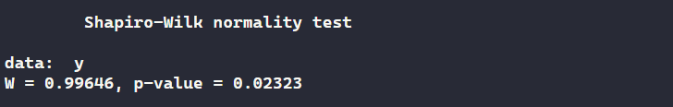
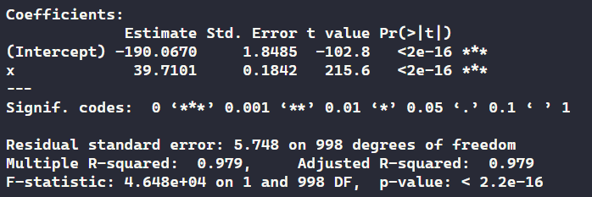
Summary

Slide 45
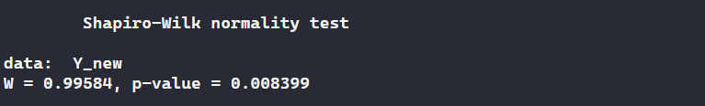
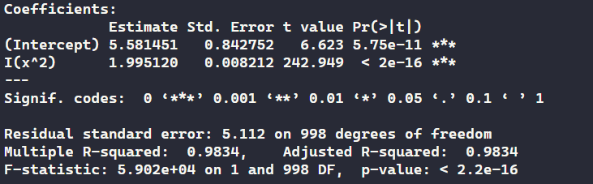
Summary

Slide 46
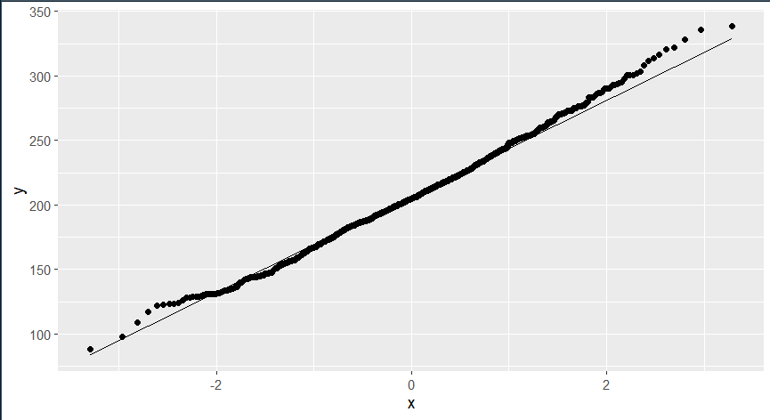
Q-Q Plot

Slide 47
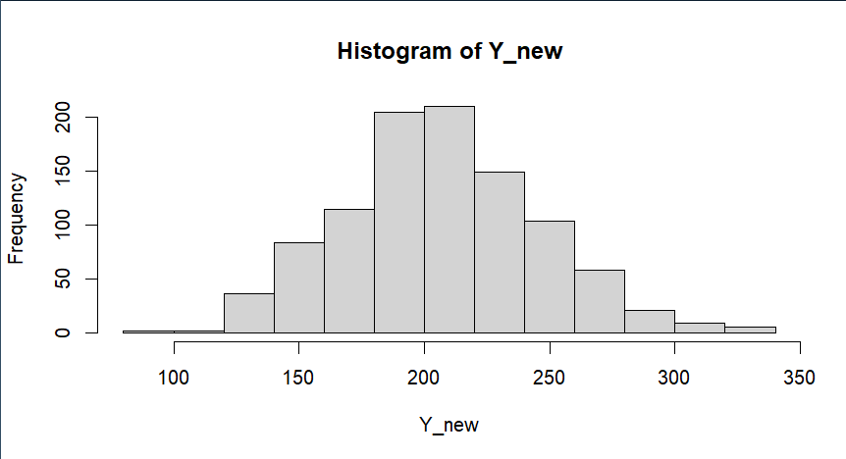
Histogram

Slide 48
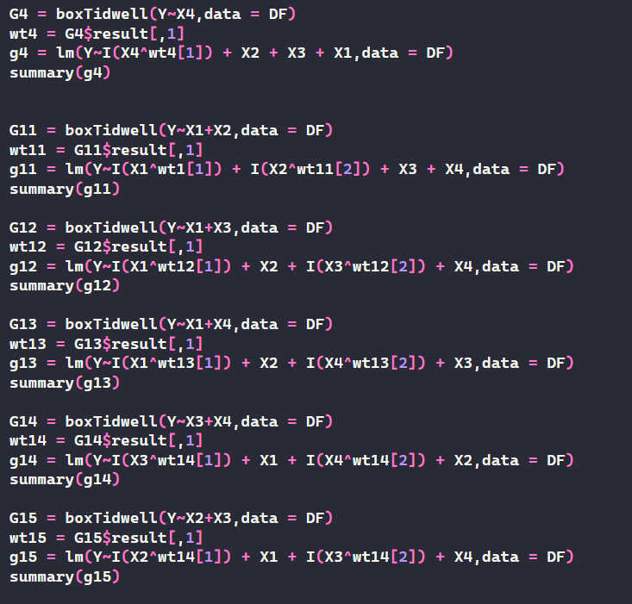

Example - 2

Slide 49

Cont..

Slide 50

Q-Q Plot

Slide 51

Histogram

Slide 52


Summary

Slide 53

Summary

Slide 54


Real Data Example

Slide 55

Data

Slide 56

Q-Q Plot

Slide 57

Histogram

Slide 58


Summary

Slide 59



Slide 60

Q-Q Plot

Slide 61

Histogram

